Slide 1
Security Assessment Report
Cross-Site Scripting Vulnerability - `vulnweb.com`

Slide 2
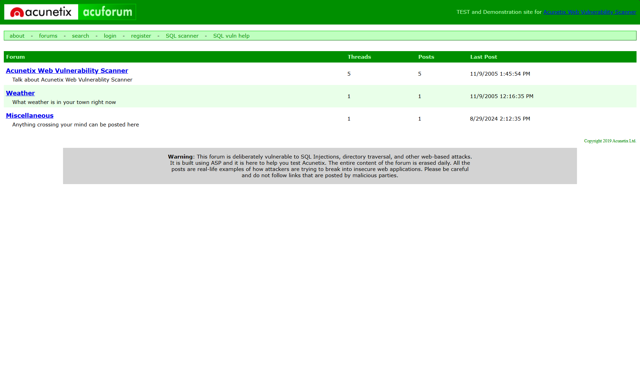
Executive Summary
This report presents the findings from a security assessment conducted on the search functionality of the `vulnweb.com` website.

Slide 3
Scope
Target: `http://testasp.vulnweb.com/Search.asp`
Tool Used: Burp Suite
Date: 28th August 2024
Vulnerability Type: Cross-Site Scripting (XSS)

Slide 4
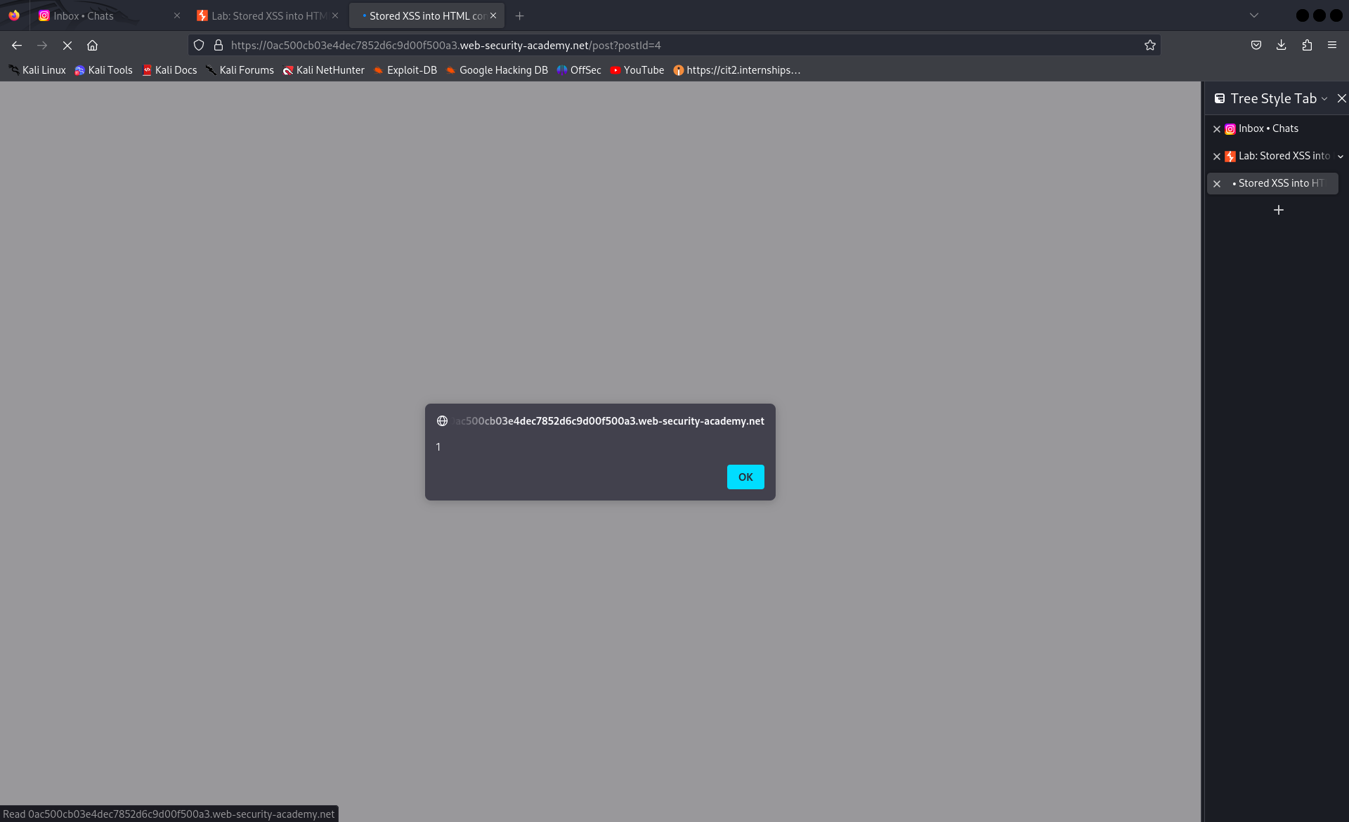
Findings
1. XSS Vulnerability Identified:
- Payloads such as `<svg onload=alert(1)>` were executed without being sanitized.
- Status Codes: All requests returned a `200` status code.

Slide 5
Impact
An attacker could exploit this vulnerability to inject malicious JavaScript, leading to:
- Theft of user sessions or credentials.
- Defacement of the website.
- Unauthorized actions on behalf of the user.

Slide 6
Recommendations
1. Implement input validation to ensure all user input is sanitized before processing.
2. Use Content Security Policy (CSP) to limit the execution of scripts.
3. Regularly review and update security measures to protect against emerging threats.

Slide 7
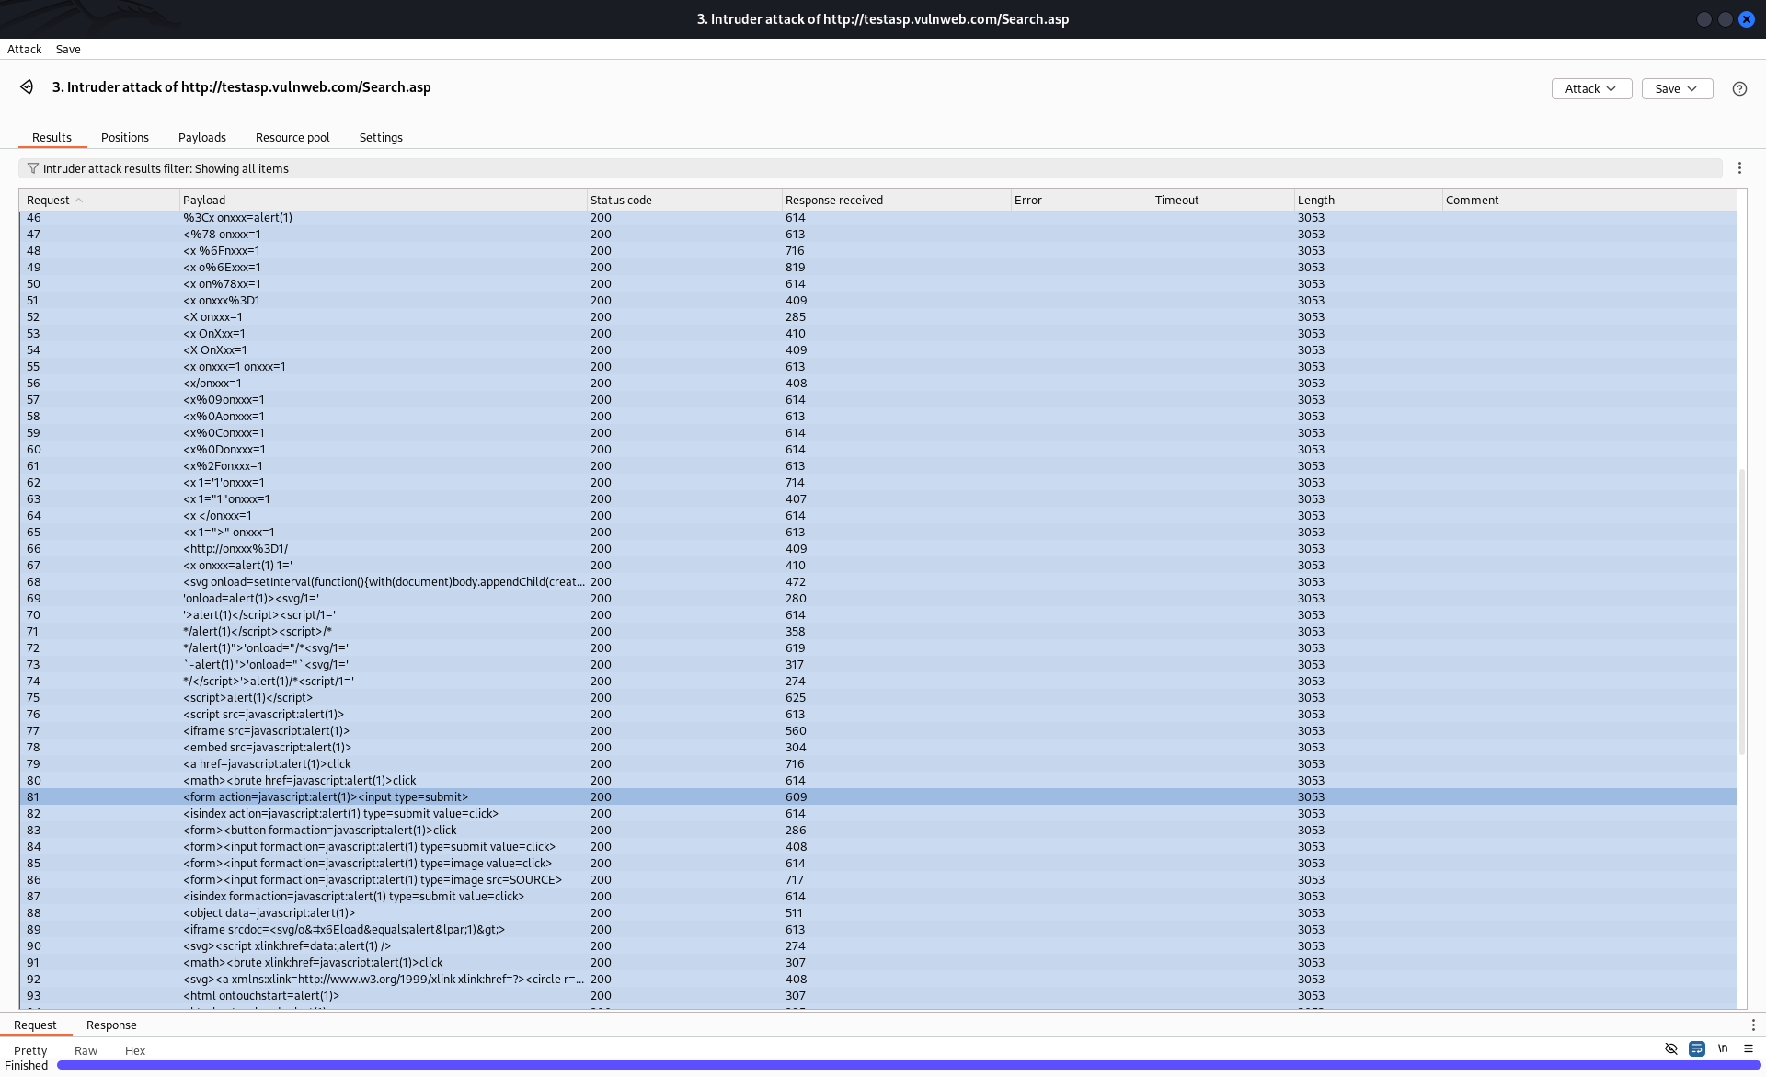
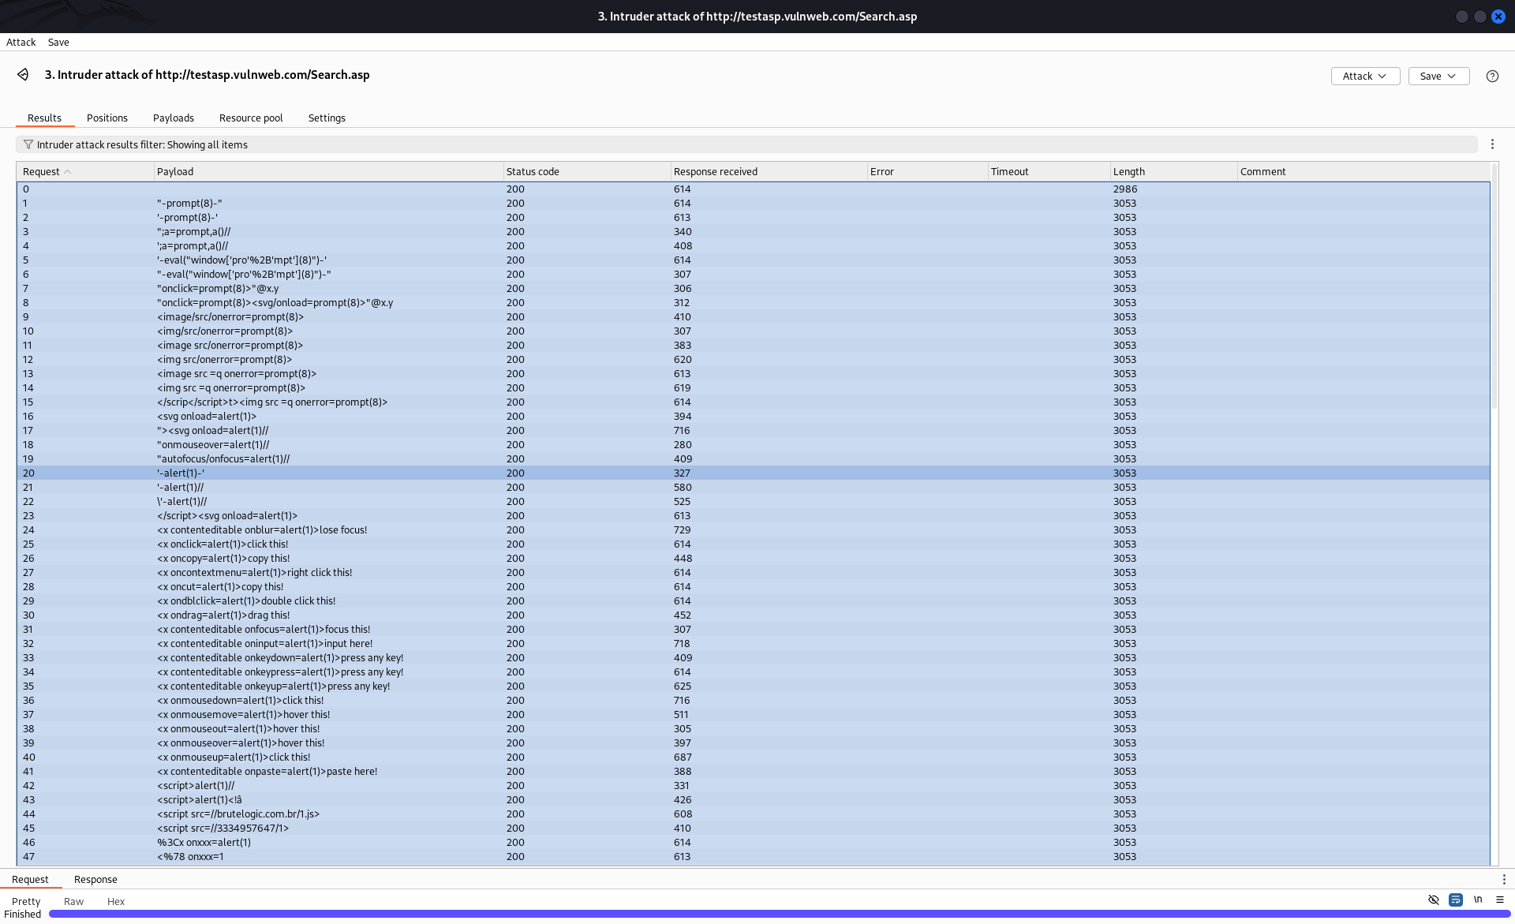
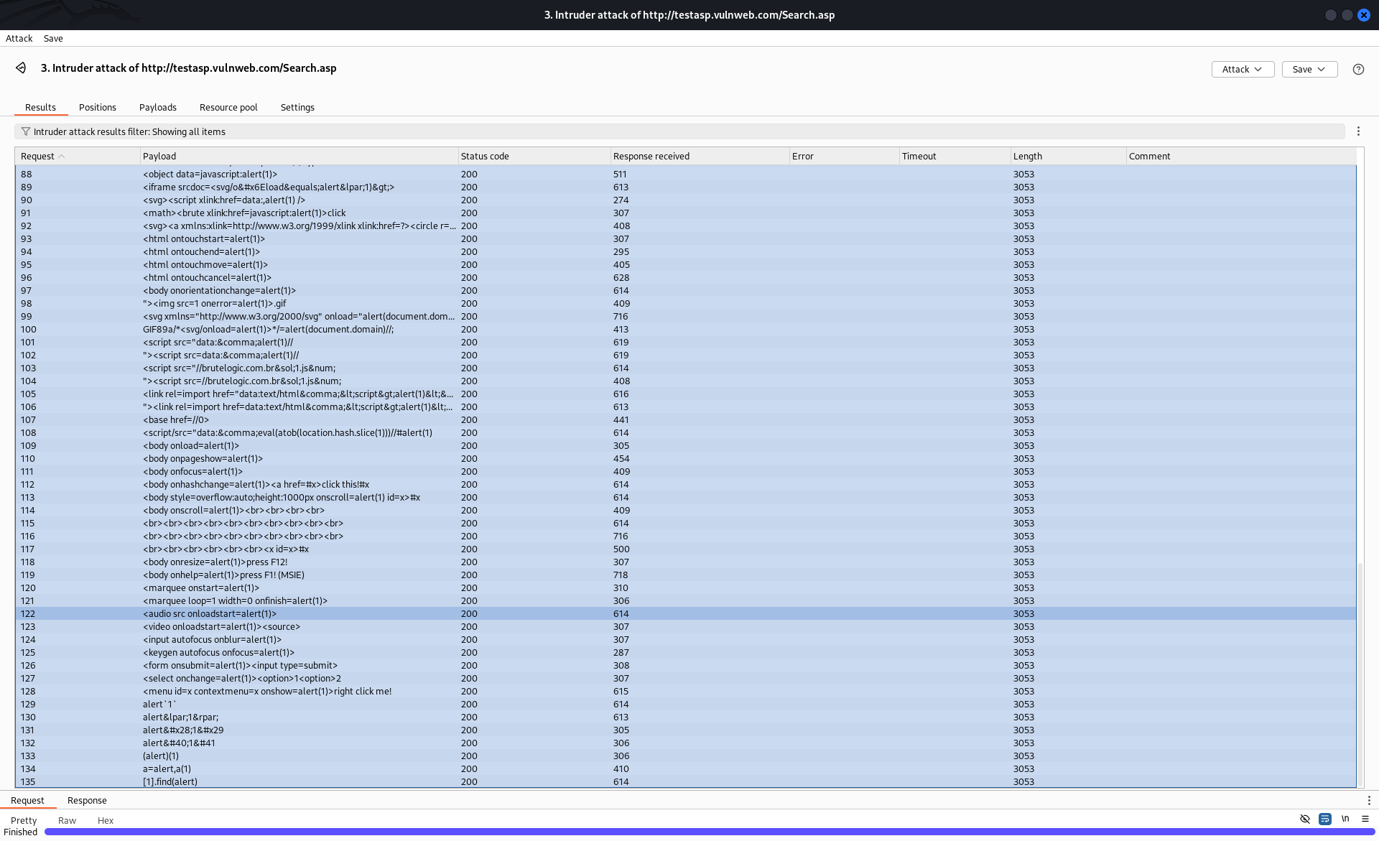
Attack Evidence

Slide 8
Conclusion
The assessment revealed critical vulnerabilities in the search functionality of the `vulnweb.com` website. Immediate action is recommended to address these issues and secure the website from potential attacks.

